Slide 1
Chapter 10-Analog to Digital Conversion

Slide 2
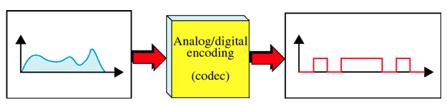
Introduction
Sometimes we need to digitize an analog signal . For example, to send human voice over a long distance, we need to digitize it since digital signals are less prone to noise. This is called an analog to digital conversion or digitizing an analog signal.
This requires a reduction of the potentially infinite number of values in an analog message so that they can be represented as a digital stream with a minimum loss of information.

Slide 3
Introduction
In analog-to-digital conversion, we are representing the information contained in a continuous wave form as a series of digital pulses.
Analog to-digital conversion can make use of any of the digital signals as discussed in line coding.
The structure of the transporting signal is not the problem.
Instead the problem is how to translate information from an infinite number of values to a discrete number of values without sacrificing sense of quality.

Slide 4
Pulse Code Modulation
The most common technique to change an analog signal to digital data (digitization) is called pulse code modulation (PCM). A PCM encoder has three processes;
The analog signal is sampled.
The sampled signal is quantized.
The quantized values are encoded as streams of bits.

Slide 5
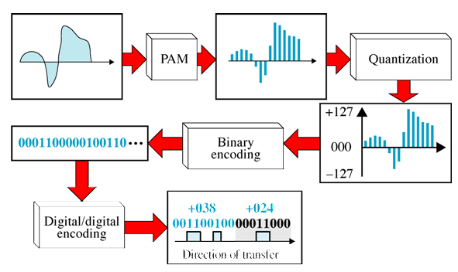
Pulse Code Modulation

Slide 6
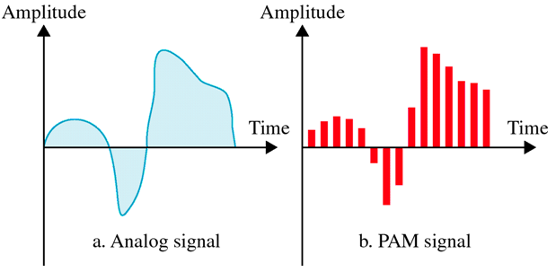
Pulse Amplitude Modulation
The first step in analog-to-digital conversion is called pulse amplitude modulation (PAM).
This technique takes an analog signal, samples it, and generates a series of pulses based on the results of the sampling.
The term sampling means measuring the amplitude of the signal at equal intervals.

Slide 7
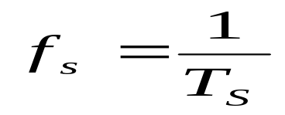
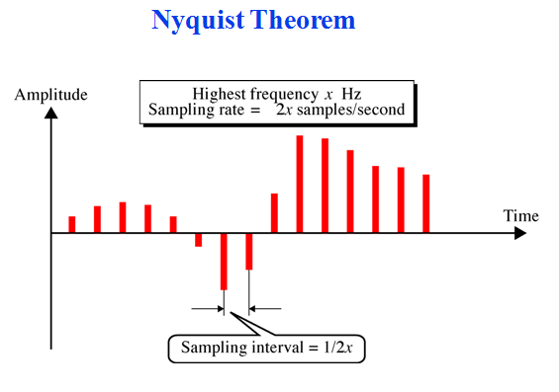
Sampling Rate
The analog signal is sampled every T_{s} second, where T_{s} is the sample interval or period.
The inverse of the sampling interval is called the sampling rate or sampling frequency and denoted by f_{s}, where
Nyquist theorem
According to the Nyquist theorem, the sampling rate must be at least 2 times the highest frequency contained in the signal.

Slide 8
Nyquist theorem
We can sample a signal only if the signal is band-limited. In other words, a signal with an infinite bandwidth cannot be sampled.
Second, the sampling rate must be at least 2 times the highest frequency, not the bandwidth.
If the analog signal is low-pass, the bandwidth and the highest frequency are the same value.
If the analog signal is bandpass, the bandwidth value is lower than the value of the maximum frequency.

Slide 9
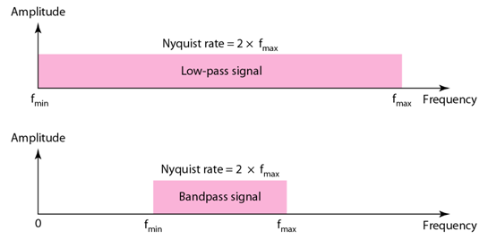
Nyquist theorem
Nyquist sampling rate for low-pass and bandpass signals is given in figure below;

Slide 10
Example
A complex low-pass signal has a bandwidth of 200 kHz. What is the minimum sampling rate for this signal?
Solution
The bandwidth of a low-pass signal is between 0 and f, where f is the maximum frequency in the signal. Therefore, we can sample this signal at 2 times the highest frequency (200 kHz). The sampling rate is therefore 400,000 samples per second.
Telephone companies digitize voice by assuming a maximum frequency of 4000 Hz. The sampling rate therefore is 8000 samples per second.

Slide 11
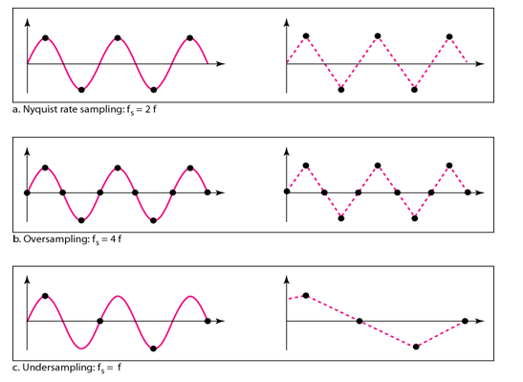
Example
For an intuitive example of the Nyquist theorem, let us sample a simple sine wave at three sampling rates: f_{s} = 4f (2 times the Nyquist rate), f_{s} = 2f (Nyquist rate), and f_{s} = f (one-half the Nyquist rate).

Slide 12
Example
It can be seen that sampling at the Nyquist rate can create a good approximation of the original sine wave (part a). Oversampling in (part b) can also create the same approximation, but it is redundant and unnecessary. Sampling below the Nyquist rate (part c) does not produce a signal that looks like the original sine wave.

Slide 13
Sampling Method
There are three sampling methods: ideal, natural, and flat top.
In ideal sampling, pulses from the analog signal are sampled. This is an ideal sampling method and cannot be easily implemented.
In natural sampling, a high-speed switch is turned on for only the small period of time when the sampling occurs. The result is a sequence of samples that retains the shape of the analog signal.
The most common sampling method, called sample and hold, however, creates flat-top samples by using a circuit.

Slide 14

Sampling Method

Slide 15
Quantization
Sampling results in a series of pulses of varying amplitude values ranging between two limits: a min and a max.
The amplitude values are infinite between the two limits.
We need to map the infinite amplitude values onto a finite set of known values.
This is achieved by dividing the distance between min and max into L zones, each of height Δ.
Δ = (max - min)/L

Slide 16
Quantization Level
The midpoint of each zone is assigned a value from 0 to L-1 (resulting in L values)
Each sample falling in a zone is then approximated to the value of the midpoint.
Quantization Zone
Assume we have a voltage signal with amplitudes V_{min}=-20V and V_{max}=+20V.
We want to use L=8 quantization levels.
Zone width Δ = (20 - (-20))/8 = 5
The 8 zones are: -20 to -15, -15 to -10, -10 to -5, -5 to 0, 0 to +5, +5 to +10, +10 to +15, +15 to +20
The midpoints are: -17.5, -12.5, -7.5, -2.5, 2.5, 7.5, 12.5, 17.5

Slide 17
Assigning Codes to zone
Each zone is then assigned a binary code.
The number of bits required to encode the zones, or the number of bits per sample as it is commonly referred to, is obtained as follows:
n_{b} = log₂ L
Given our example, n_{b} = 3
The 8 zone (or level) codes are therefore: 000, 001, 010, 011, 100, 101, 110, and 111
Assigning codes to zones:
  000 will refer to zone -20 to -15
  001 to zone -15 to -10, etc.

Slide 18
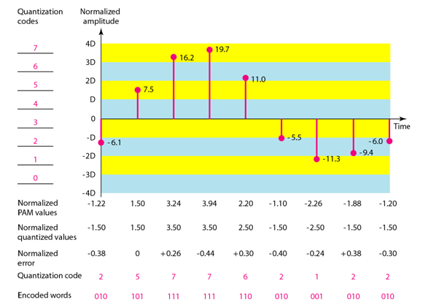
Example

Slide 19
Example
We have shown only nine samples using ideal sampling (for simplicity).
The value at the top of each sample in the graph shows the actual amplitude.
In the chart, the first row is the normalized value for each sample (actual amplitude/Δ).
The quantization process selects the quantization value from the middle of each zone.
This means that the normalized quantized values (second row) are different from the normalized amplitudes. The difference is called the normalized error (third row).
The fourth row is the quantization code for each sample based on the quantization levels at the left of the graph.
The encoded words (fifth row) are the final products of the conversion.

Slide 20
Quantization Error
When a signal is quantized, we introduce an error - the coded signal is an approximation of the actual amplitude value.
The difference between actual and coded value (midpoint) is referred to as the quantization error.
The more zones, the smaller Δ which results in smaller errors.
But, the more zones the more bits required to encode the samples -> higher bit rate.
Bit rate of PCM
The bit rate of a PCM signal can be calculated form the number of bits per sample × the sampling rate
Bit rate = n_{b} x f_{s}

Slide 21

Example
What is the sampling rate and bit rate of human voice?
Solution
The human voice normally contains frequencies from 0 to 4000 Hz. So the sampling rate and bit rate are calculated as follows:
Question
Why has the PCM sampling time been set at 125 µsec?

Slide 22
Example
Explain the process of a Pulse Code Modulation (PCM) Encoder?

Slide 23
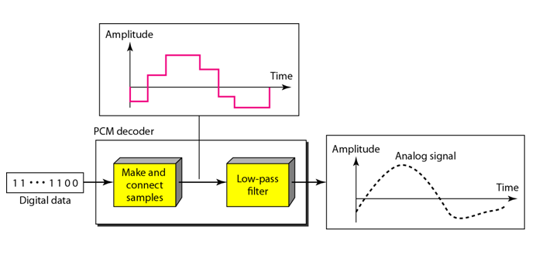
Original Signal Recovery
The recovery of the original signal requires the PCM decoder. The decoder first uses circuitry to convert the code words into a pulse that holds the amplitude until the next pulse. After the staircase signal is completed, it is passed through a low-pass filter to smooth the staircase signal into an analog signal. If the signal has been sampled at (or greater than) the Nyquist sampling rate and if there are enough quantization levels, the original signal will be recreated. Note that the maximum and minimum values of the original signal can be achieved by using amplification.

